Slide 1
The Battle of Neighbourhoods
Final Presentation for Coursera Capstone Project

Slide 2
Introduction
Toronto, Canada and Bangalore, India are two major cities in the world. Both cities become a centre of attention for residential, job employment, tourism, education, shopping and sports activity.
In this project, we will study in details the area classification using Foursquare data and ML segmentation and clustering (K-Mean Algorithm). The aim of this project is to segment areas of Toronto and Bangalore based on the most common places captured from Foursquare.
Using segmentation and clustering, we hope we can determine:
The similarity or dissimilarity of both cities
Classification of area located inside the city whether it is residential, tourism places, or others

Slide 3
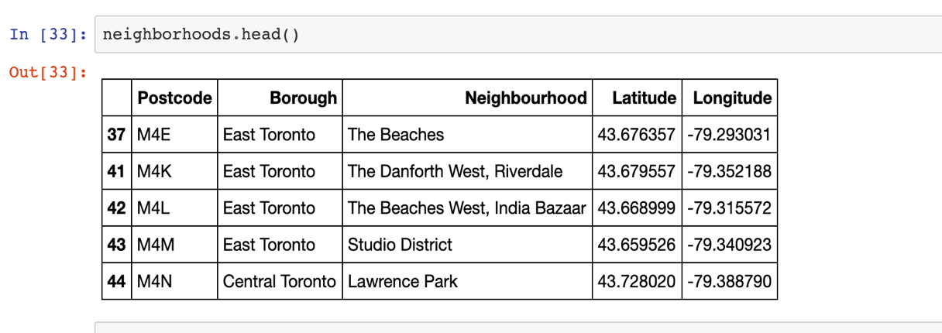
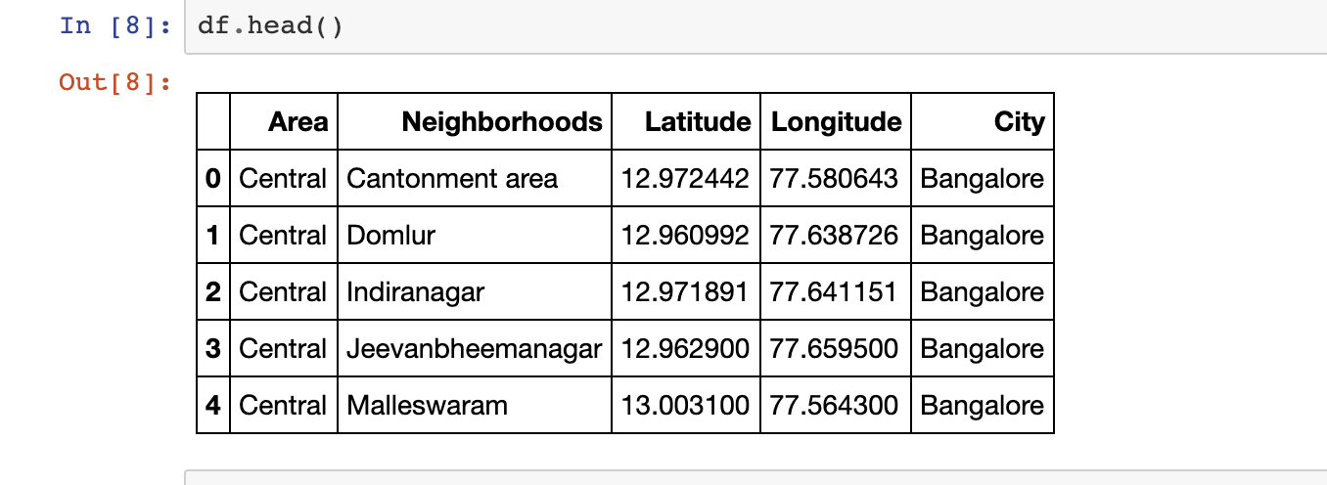
Data Scraping and Preparation
Toronto Data
Bangalore Data

Slide 4
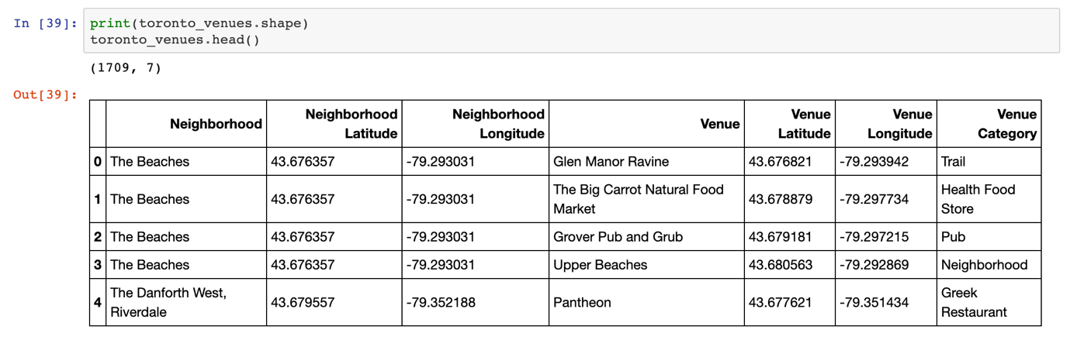
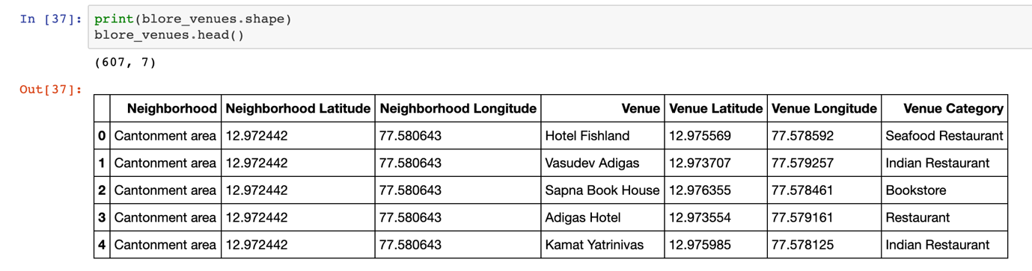
Neighborhoods Data for the cities
Toronto neighborhoods data
Bangalore neighborhoods data

Slide 5
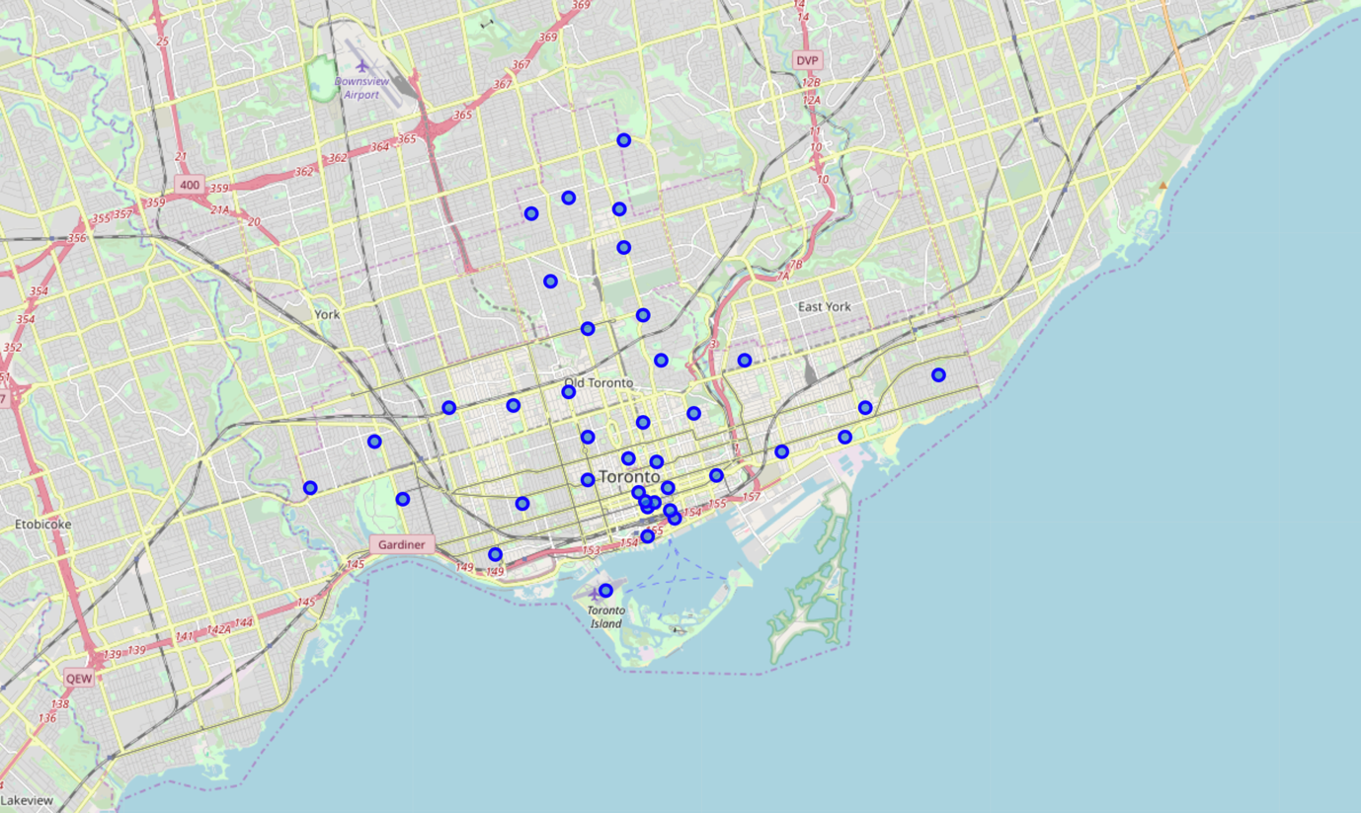
Visualize the data points - Toronto

Slide 6
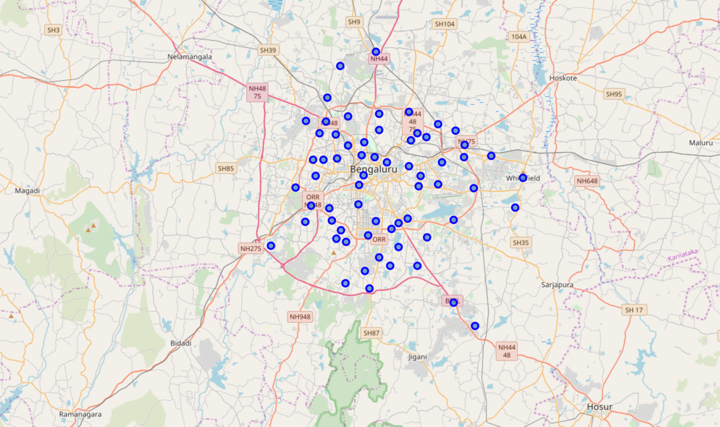
Visualize the data points - Bangalore

Slide 7
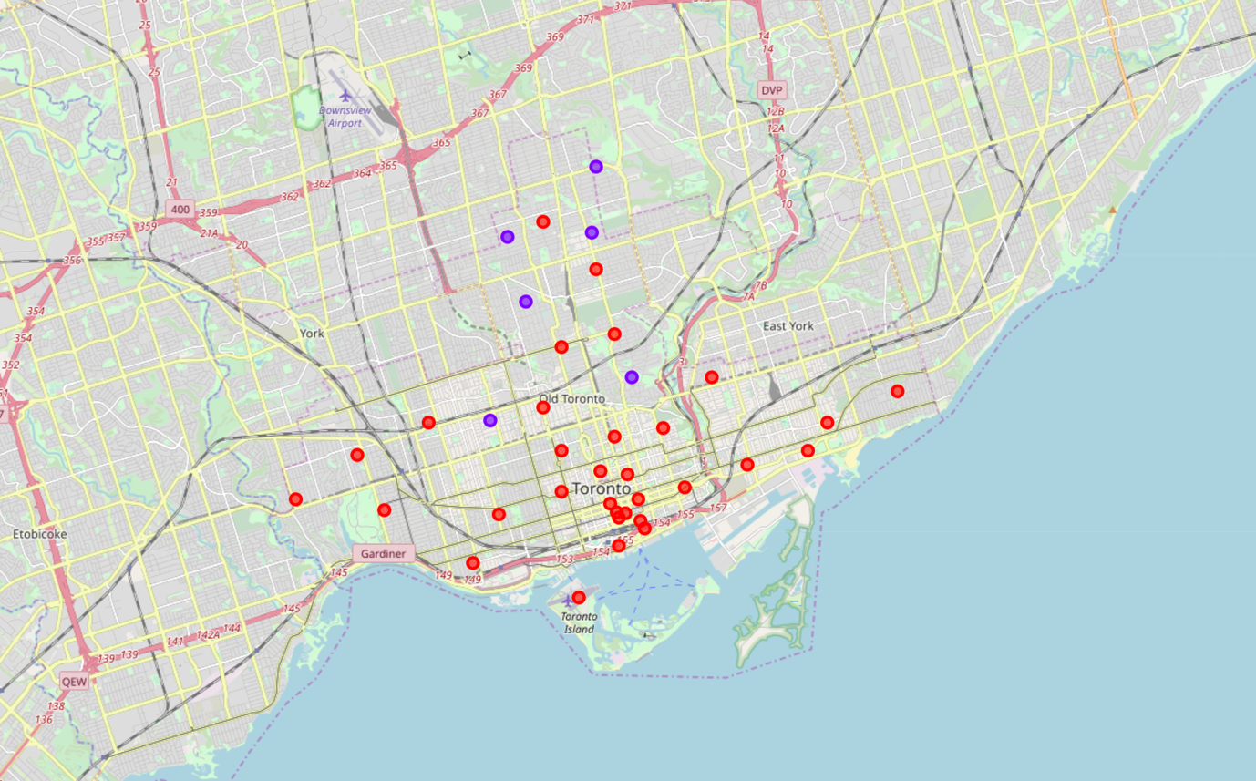
After Clustering – Data points - Toronto

Slide 8
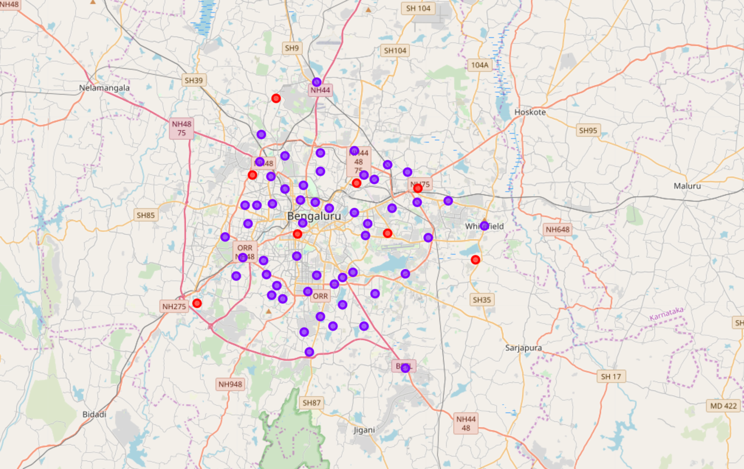
After Clustering – Data points - Bangalore

Slide 9
Final Results and Conclusion
Cluster 1: Toronto: Restaurants and Cafe
Cluster 2: Toronto: Tourist spots for roaming
Cluster 1: Bangalore: Tourist spots or places
Cluster 2: Bangalore: Mostly Restaurants and other shops

